Slide 1

Accident Detection System
Team id: FTH51
Hardik and Japneet

Slide 2
Team Details
Team member 1: HARDIK ,XI,15
Team member 2: JAPNEET,XI,16

Slide 3
The Problem
A whopping 4,64,910 road accidents were reported in India in 2017 leading to the death of 1,47,913 people, according to the Transport Research Wing of the Ministry of Road Transport and Highways
Most of the deaths in road accidents take place due delay in access of emergency services.
Most pedestrians do not report the accident
Accidents may take place in remote areas
We are lacking a mechanism to detect accidents

Slide 4
THE SOLUTION
We have developed a smart accident detection system
We have used arduino uno r3 microcontroller , gps and gsm modems and a lcd display.
This is a completely new innovation and has not been implemented at all
Companies like Tesla have integrated accident prevention system but , this idea is the first of its kind.

Slide 5
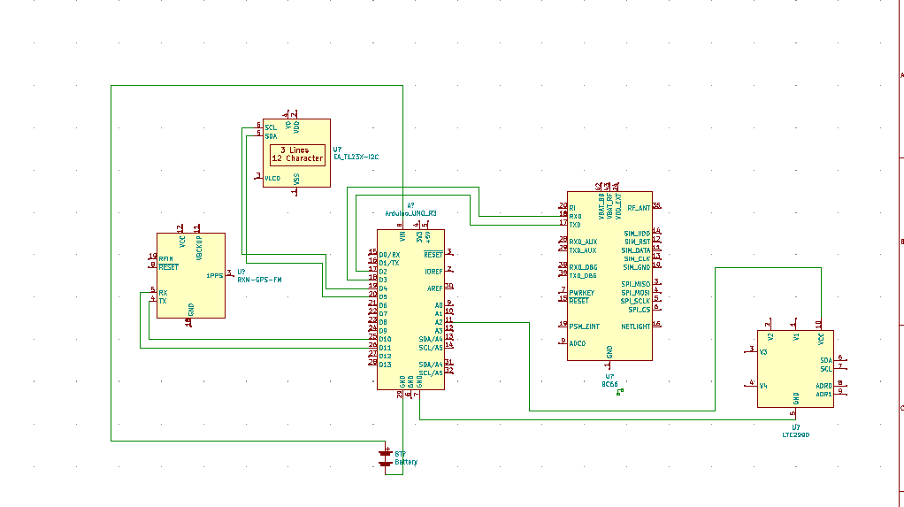

Slide 6
Impact of the solution
It is expected to get large support and hundreds of thousands of potential customers as such an idea is highly desired among consumers.
It will affect hundreds of thousands of lives.
According to online petitions and consumer surveys by news sources , such a solution is highly required

Slide 7
Business Model
As the device can be used with existing car components like accelerometers , speedometer and GPS –it can easily be taken to the markets.
We are expected to capture hundreds of thousands of customers via manufacturers within 3 months and awareness for such ideas is also increasing.
The product is highly scalable as it is commercially viable(max cost rs.1500) and compact due to which it can be integrated into new cars and old cars as well.It an be used with existing hardware.

Slide 8
THANK YOU

